Slide 1

HubLink: Leveraging Language Models for Enhanced Scholarly Information Retrieval on Research Knowledge Graphs
by Marco Schneider
Master Thesis
supervised by Angelika Kaplan & Jan Keim

Slide 2

Motivation Literature Research is Hard
Typical Academic Researcher
Current practice to conduct literature search is a time-consuming and cognitively taxing process.
Two interesting concepts:
Research Knowledge Graphs (RKGs)
Store and interconnect scientific findings instead of embedding them in long texts.
But are difficult for users to access.
Large Language Models (LLMs)
Demonstrate powerful capabilities in Natural Language Processing.
But have difficulties with specialized domains and hallucinations.
OpenAI. (2024). Cartoon-style image of a frustrated academic researcher.
Created with DALL-E. Retrieved on July 4, 2024

Slide 3



Idea Unifying LLMs with RKGs
Question
LLM-based QA System
Research Knowledge Graph
Answer
“Retrieval Augmented Generation”
Idea: Combine both concepts in a Knowledge Graph Question Answering (KGQA) setting to enhance scholarly information retrieval.

Slide 4
Fundamentals For this Presentation
List
Literal
Contribution
authors
contribution
doi
Knowledge Graphs (KGs) [Banerjee2024, Pan2024]
Are networks that store structured data.
Consists of triples in the RDF format: (subject, predicate, object).
Research Knowledge Graphs (RKGs) [Auer2018]
Are KGs that are focused on storing scholarly statements.
For example, the Open Research Knowledge Graph (RKG).
Knowledge Graph Question Answering (KGQA) [Banerjee2024, Chakraborty2021, Pan2024, Yani2022]
Research area focused on empowering users to access information stored within a KG by formulating questions in natural language.
Paper
year
Venue
Literal
venue
month
research field
Literal
ResearchField
Contribution
research field
Literal
contribution
Paper
doi
year
Venue
Literal
venue
month
authors
Literal
List
Visualization of the ORKG Graph

Slide 5
Related Work Scholarly KGQA Approaches
Current efforts for scholarly KGQA are primarily Semantic Parsing (SP) methods [Jaradeh2020, Devlin2019, Banerjee2023, Raffel2023, Li2024, Taffa2023, Lehmann2024, Jiang2023].
These approaches translate natural language into formal queries, such as SPARQL, by identifying relevant entities and relations in the RKG [Zhang2023].
Not Schema-Agnostic: These approaches degrade when applied to larger and dynamic graphs where unseen schema components and entities are common [Gu2022].
Require Training-Data: The approaches rely on task-specific training examples for efficient retrieval, limiting adaptability and scalability.

Slide 6
Related Work Training-Free & Schema Agnostic KGQA Approaches
Current related training-free and schema-agnostic KGQA approaches in the literature can be differentiated between:
Stepwise-Reasoning for example FiDeLiS [Sui2024].
Subgraph Construction for example Mindmap [Wen2024].
Vector-Based for example DiFaR [Baek2023].
They all demonstrate state-of-the-art performance in their respective experiments.
However, they have only been evaluated on open-domain graphs and not yet been tested in the scholarly domain !
And they do not consider the source of knowledge during inference.
Notes:
<7:30
Stepwise-Reasoning approaches decompose the reasoning task into smaller, manageable steps, iteratively querying the KG and using the LLM to guide the process towards the answer
Subgraph Construction approaches dynamically construct subgraphs during the retrieval process to provide contextual information for the LLM answer generation
Vector-Based approaches create a vector index of the KG in an offline pre-processing step to later efficiently query context for the LLM answer generation

Slide 7
Summary Problems and Contributions
I identified…
… a research gap for applying alternative (non semantic parsing) and LLM-based strategies on the scholarly KGQA task.
… that current KGQA approaches do not consider the source of knowledge during inference.
… a lack of a taxonomy to classify the characteristics of questions posed to KGQA retrieval systems for scholarly tasks.
I contribute…
… a novel LLM-based KGQA approach named “HubLink”. (schema-agnostic, no training data, source-aware inference)
… a Question Taxonomy for classifying questions targeting scholarly KGQA. (to evaluate performance and capabilities of systems)
… new KGQA Datasets for the ORKG. (to benchmark performance and robustness)
Notes:
… a novel LLM-based KGQA approach named “HubLink” that is both schema-agnostic and does not require training data, designed to conduct source-aware inference on RKG.
… a Question Taxonomy for classifying questions targeting scholarly KGQA, facilitating the development of diverse datasets to evaluate the performance and capabilities of retrieval systems.
… a new KGQA Dataset for the Open Research Knowledge Graph (ORKG), featuring four variants for different graph schemas, designed to benchmark the performance and robustness of KGQA systems across a wide range of question types in the scholarly literature search task.
Animation
Matching ist verwirrend.

Slide 8
Actions The Research Workflow
KGQA
Graph Preparation
Data Preparation
Experimentation
Develop
SQA-Framework
Prepare Labeled* Publication Data
Tax. Construction Process
Run Parameter Selection Process
Implement existing Retrievers
Prepare ORKG Templates
Develop KGQA Taxonomy
Run Experiments
Impl. Evaluation Framework
Develop QA Generation Strategies
Autom. Add Labeled* Papers to ORKG
Analyze and Conclude
Develop HubLink
Create KGQA Datasets
* Based on the work by [Konersmann2022]
Notes:
<11min

Slide 9
HubLink
KGQA Retrieval Approach

Slide 10
HubLink Concept
Index
Hub 1
The large graph is decomposed into subgraphs called “Hubs” and stored in an index.
At query time, the most relevant hubs are retrieved from the index and partial answers are generated.
These are then synthesized into a final answer.
Hub 2
Partial Answers
Final Answer
Top k Hubs
Synthesized Answer
Hub Answer 1
Hub Answer 3
Hub 3

Slide 11
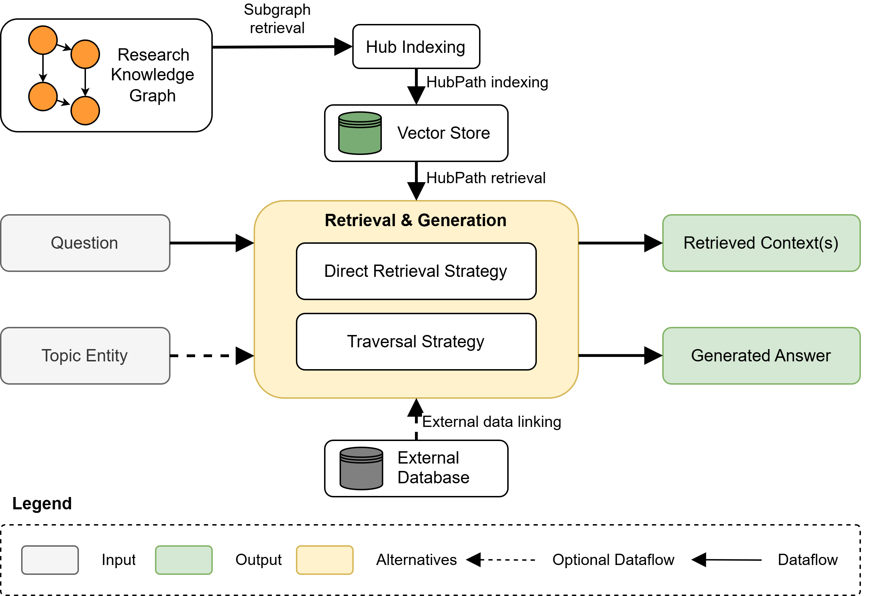
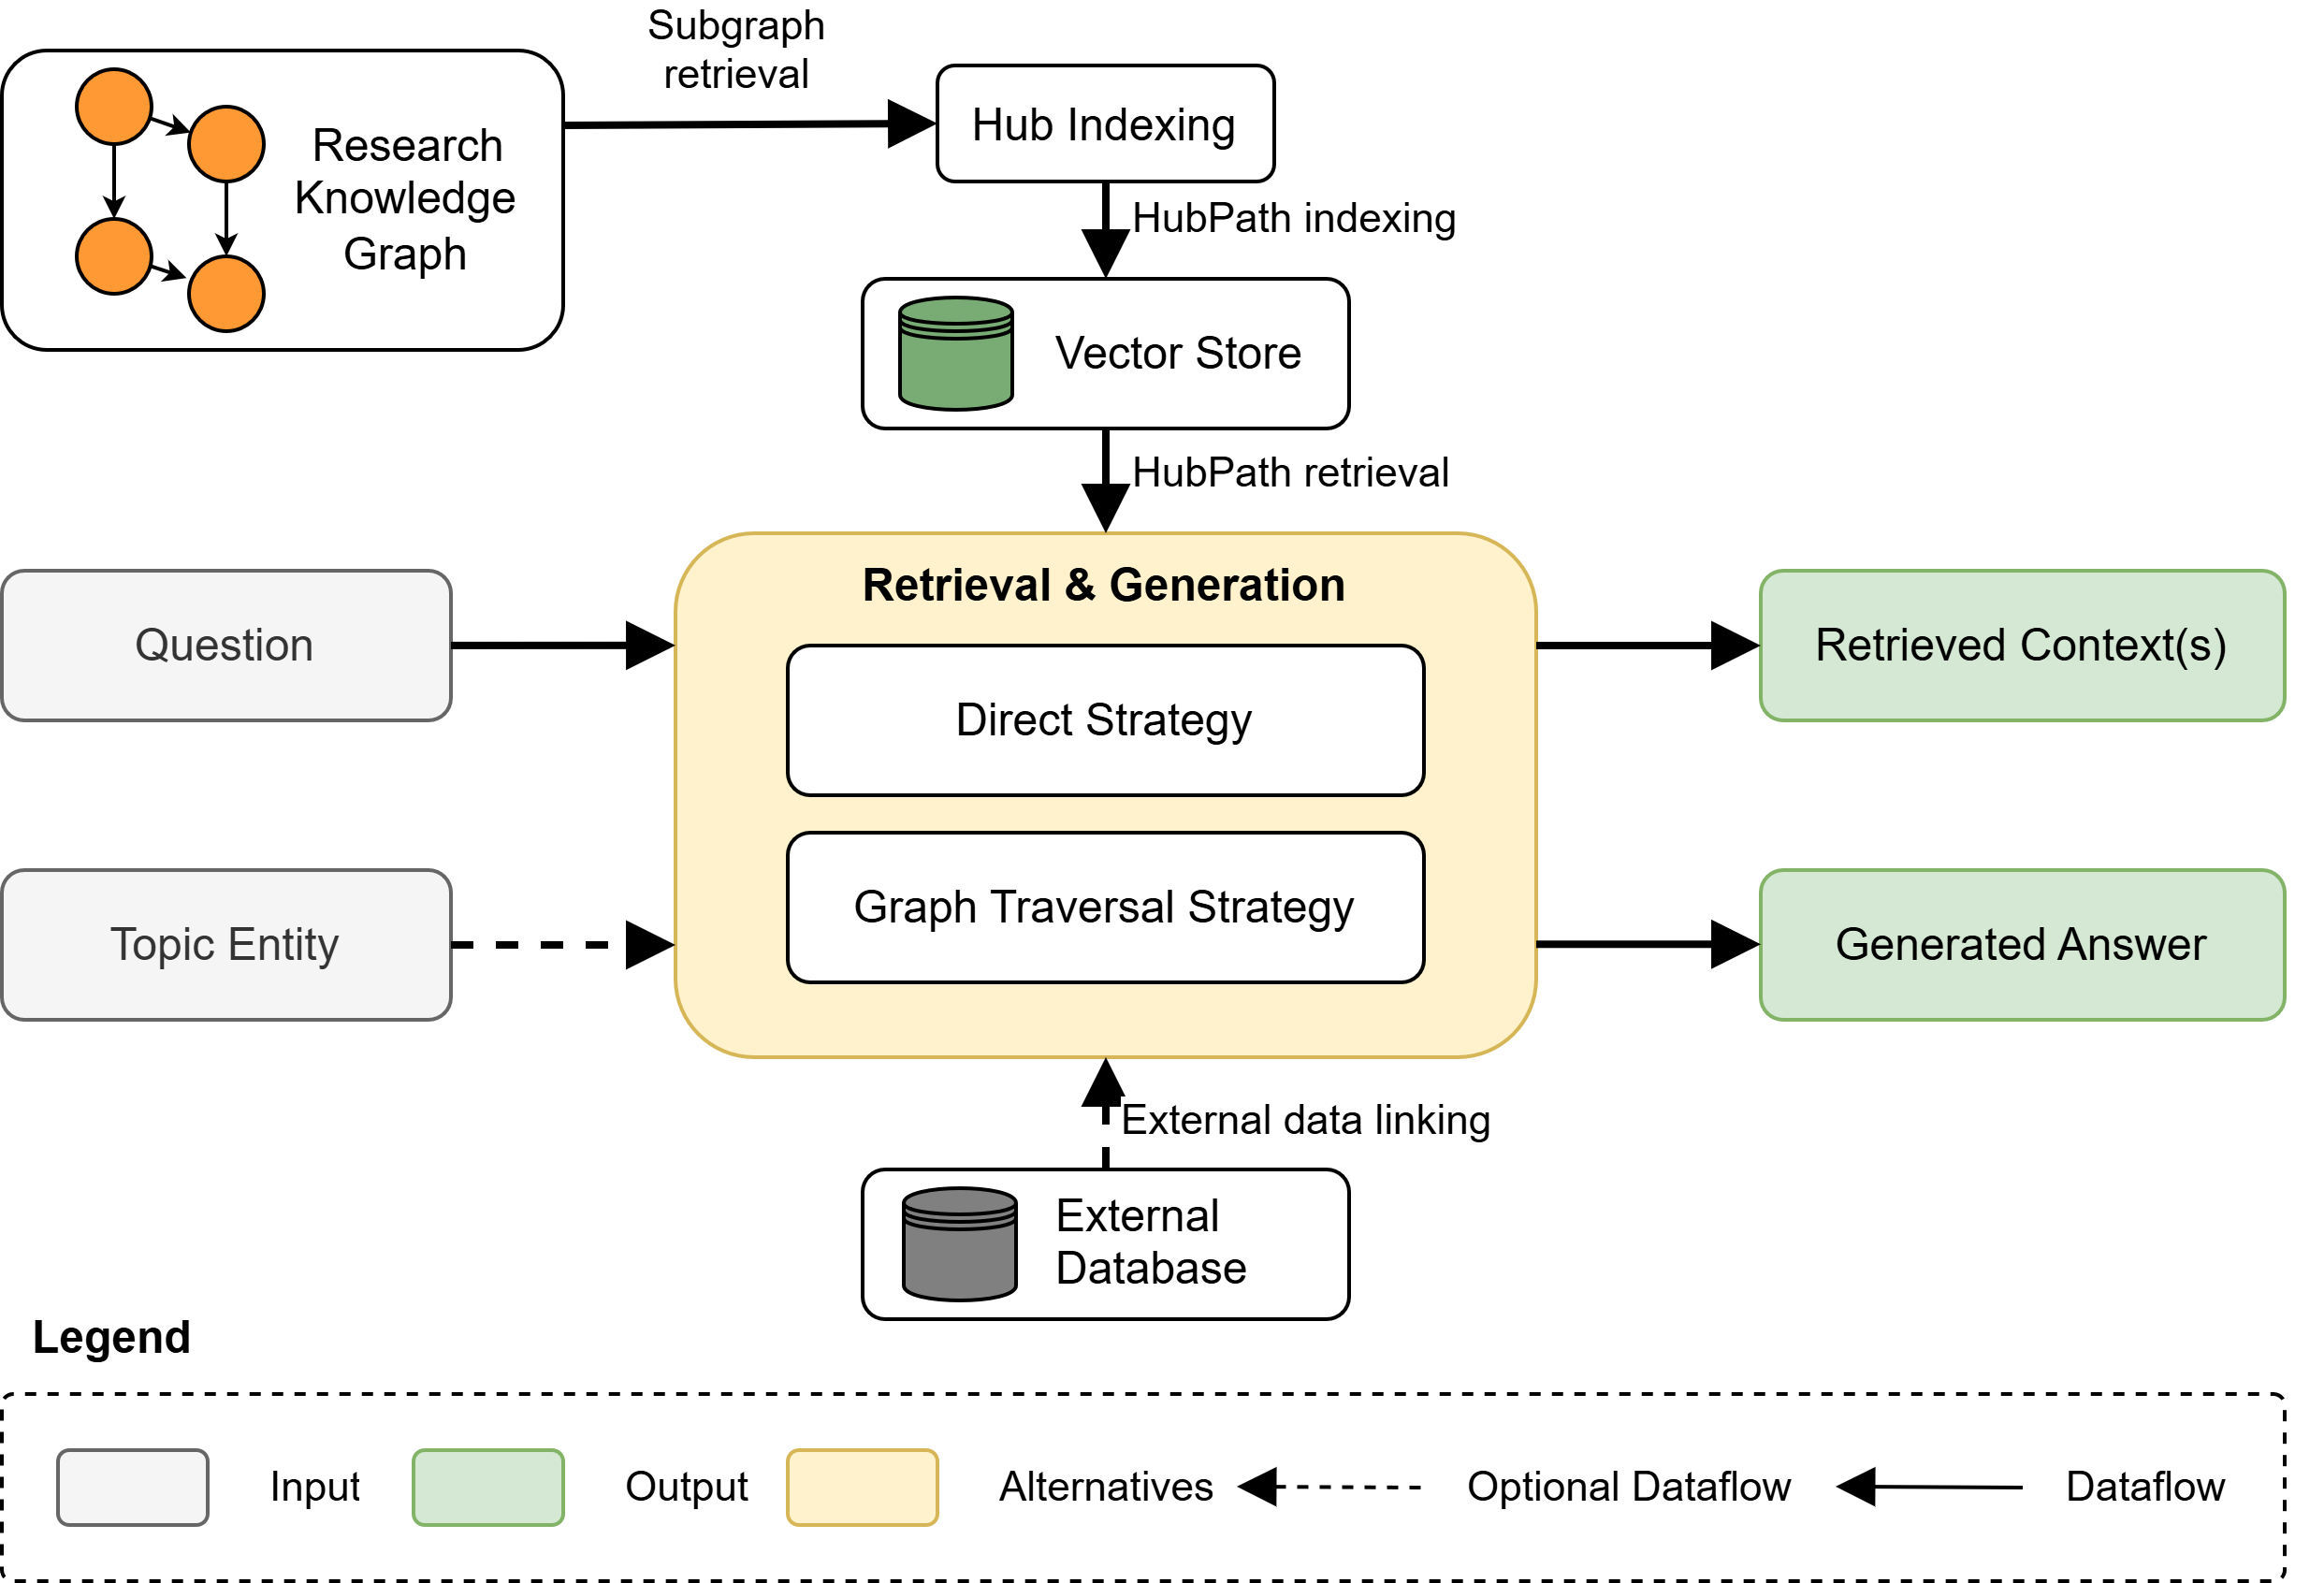
HubLink Overview
The new KGQA approach has three phases:
Three Phases
Indexing
Retrieval
Generation
(e.g., full text chunks)

Slide 12
HubLink Indexing Process
Given: Is a list of Start Points from which the indexing is started.
Search: The graph is traversed to find entities that are roots of Hubs.

Slide 13
HubLink Indexing Process
Hub
Title
Author
hasTitle
hasAuthor
Paper 1
hasAuthors
Authors
Author
hasResearchObject
ResearchObject
Evaluation
Properties
hasEvaluation
hasProperties
Building Hubs: Each Hub is then build starting from the root entity and subsequently stored in the vector store.

Slide 14
HubLink Indexing Process
Paper 1
hasTitle
Title
Paper 1
hasAuthors
Authors
hasAuthor
Author
Paper 1
hasAuthors
Authors
hasAuthor
Author
hasResearchObject
hasProperties
Paper 1
ResearchObject
hasEvaluation
Evaluation
Properties
Building Hubs: The triple paths of the hub are extracted from the graph.

Slide 15
HubLink Indexing Process
Triples
Path Description
Entities
Predicates
hasDoi
The paper has the doi “Doi1”
Paper 1
Paper 1
Doi1
hasDoi
Doi1
Pre-Trained Embedding Model
(7, 3, 8, 3, …)
(0, 1, 5, 2, …)
(8, 9, 9, 1, …)
(6, 1, 2, 7, …)
(2, 1, 2, 1, …)
Index
Building Hubs: The paths are converted to four different vectors at different content levels which are then stored in a vector index (including metadata for tracing).
Finding more Hubs: The graph is further traversed to find and index more hubs.
Notes:
15 und 16 mergen?

Slide 16
HubLink Direct Retrieval Strategy
What papers published by IEEE talk about the concept of prompt engineering?
Vector 1
Decompose: Decompose the question into components.
Embed: Embed the question and the components into vectors.
Retrieve: Query the index to find relevant hub paths.
Vector 2
Decomposed
Vector 3
Papers
IEEE
published
Vector 4
Prompt Engineering
Vector 5
Approximate Nearest Neighbor (ANN) search
Vector Index
Notes:
<17

Slide 17
HubLink Direct Retrieval Strategy
Hub 1
Hub n
Hub Path 1
0.87
Hub Path 1
0.98
Hub Path 2
0.79
Hub Path 2
0.95
…
…
Hub Path 3
0.77
…
Hub Path 3
0.82
Deduplication
Diversity Ranking
Hub Path 4
0.68
Hub Path 4
0.80
Vector Index
Hub Path 5
0.65
Hub Path 5
0.78
Post-Process: Deduplication, Diversification and Hub Clustering of the hub paths.
Score: Calculate the total score for each Hub.
Calculating total Hub scores using a weighted averaging
Hub 1
0.75
…
Hub n
0.89

Slide 18
HubLink Direct Retrieval Strategy
Collected Hubs
Relevant Hubs
Hub Answers
Hub 1
0.89
Hub 1
0.89
Partial Answer
Hub 2
0.75
Hub 2
0.75
Partial Answer
Hub 3
0.72
Hub 3
0.72
Partial Answer
Final Answer
…
Only keep top k
…
Generate
…
Hub n
0.31
Hub k
0.66
Partial Answer
Linking
Enrich with
external data
(e.g., full text)
Pruning: Only keep the top k scoring hubs.
Linking: Optionally enrich each hub with external data.
Answer Generation: Generate for each hub a partial answer and synthesize to a final answer.
External
Database

Slide 19

HubLink Graph Traversal Strategy
Question
What papers published by IEEE talk about the concept of prompt engineering?
…
…
Vector Index
Targeted search
Topic Entity
Software Architecture Research Field
RKG
In Principle the same as the direct strategy but
… requires a topic entity.
… also traverses the graph to utilize a targeted search.

Slide 20
HubLink General Limitations
Requires the maintenance of an index, as only data that is indexed can be retrieved.
Requires well-defined criteria for hub structures to index all relevant knowledge.
Inherits limitations of embedding-based systems.
Performance strongly depends on the LLM that is used.
Notes:
<21

Slide 21
Research Data
The data that was used to conduct the experimentation

Slide 22
Research Data Open Research Knowledge Graph
List
Literal
Contribution
authors
contribution
doi
Papers are added in a community effort by adding them based on templates.
Templates
Are predefined structures that guide users in adding a new paper to the ORKG graph.
Help standardize the representation of various types of research contributions.
Paper
year
Venue
Literal
venue
month
research field
Literal
ResearchField
Contribution
research field
Literal
contribution
Paper
doi
year
Venue
Literal
venue
month
authors
Literal
List
Visualization of the ORKG Graph

Slide 23
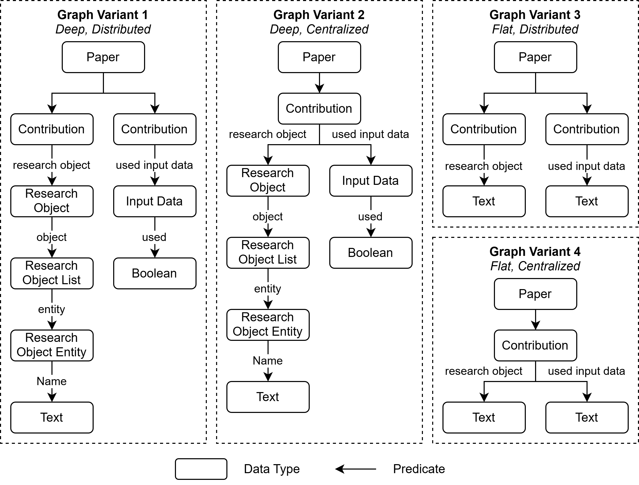
Research Data Template Variants
I created four different templates based on a Software Architecture classification schema [Konersmann2022].
Variations between deep paths and distributed paths.
For experiments only involving one variant, I chose GV1 as it is the model most realistically used in the real world.
(Excerpt)

Slide 24
Evaluation
Evaluating HubLink against state-of-the-art KGQA approaches on the ORKG

Slide 25
Evaluation Goal-Question-Metric Plan
Generation
Goal 1: Relevance & robustness of retrieved contexts.
Q1: Improvement of overall retrieval performance.
Q2: Impact of retrieval operation.
Q3: Performance on six concrete literature search use cases.
Q4: Impact of type information in question.
Q5: Robustness to alternative graph schemas.
Q6: Runtime & token efficiency.
Q7: Environmental impact.
Metrics: Precision, Recall, F1, Hits@k, EM@k, MRR@k, MAP@k
Goal 2: Semantic and factual answer alignment to reference answers.
Q8: Improvement of semantic and factual alignment.
Metrics: BLEU, ROUGE, Semantic Similarity, String Similarity, Bert-Score, Factual Correctness (LLM)
Goal 3: Answer alignment with intent and content of the question.
Q9: Improvement of semantic intent.
Q10: Improvement of instruction following.
Metrics: Answer Relevancy (LLM), Instruction Following (LLM)
Goal 4: Answer alignment to retrieved contexts.
Q11: Faithfulness of generated answers.
Metrics: Faithfulness (LLM)
Retrieval

Slide 26
Evaluation Tested HubLink Configurations
HubLink (T)
HubLink (D)
Parameter | Value
LLM | Gpt-o3-mini
Embedding | Text-embedding-3-large
Strategy | Graph Traversal
Hub Paths to Keep | 10
Number of Hubs | 30
Parameter | Value
LLM | Gpt-o3-mini
Embedding | Text-embedding-3-large
Strategy | Direct
Hub Paths to Keep | 10
Number of Hubs | 30
HubLink (F)
HubLink (O)
Parameter | Value
LLM | Gpt-o3-mini
Embedding | Text-embedding-3-large
Strategy | Direct
Hub Paths to Keep | 10
Number of Hubs | 10
Parameter | Value
LLM | Qwen2.5-14B
Embedding | mxbai-embed-large
Strategy | Graph Traversal
Hub Paths to Keep | 10
Number of Hubs | 30
Notes:
<25

Slide 27
Evaluation Overall Retrieval Performance
Significantly improved performance compared to baselines
Graph traversal strategy is superior
Fewer hubs improve precision
LLM models have a great influence
Precision and ranking scores indicate limitations

Slide 28
Evaluation Graph Robustness
Baselines perform significantly better on GV3 and GV4
HubLink also shows a better performance but less pronounced
Precision and ranking performance has the greatest increase
HubLink can be applied without adaption to other graph variants which shows that it is schema-agnostic

Slide 29
Evaluation Answer Generation
HubLink tends to generate comprehensive answers compared to the reference answers
Overall inclusion of facts seems to have limitations
Notes:
<28:30

Slide 30
Evaluation Advantages & Limitations
Retrieval Performance
Considerable advancement in retrieving scholarly knowledge
Performance is better on graphs with shorter paths
Although the recall is high the precision and ranking scores indicate difficulties
Generation Performance
Many facts are translated into the answer, but …
… absolute generation recall scores are lower than retrieval recall scores, indicating that facts are missing in the answer
Generated answers are comprehensive instead of a precise representation

Slide 31
Conclusion
HubLink to improve scholarly information retrieval in KGQA

Slide 32
Conclusion
Final Remarks
Future Work
HubLink has the potential to improve the current scholarly literature research workflow and provides a substantial advancement for schema-agnostic and training-free KGQA approaches.
The Taxonomy can help in the development and evaluation of KGQA systems.
The KGQA Datasets can be used to evaluate the performance of KGQA systems and assess their retrieval capabilities on the ORKG.
Addressing limitations of HubLink.
Applying HubLink on other RKGs or KGs for other domains.
Apply HubLink in a document-based setting (returns document chunks, uses graph as supporting structure) utilizing the linking feature of HubLink.
Extending Hubs with additional data such as summaries or precomputed insights.

Slide 33
Problem, Idea, Benefit, Actions (PIBA)
Problem
Idea
Literature research is a cumbersome process and current KGQA approaches have difficulties in real world settings.
Develop a new KGQA approach and taxonomy to foster research on how LLMs can be leveraged to enhance the quality and reliability of content retrieved from RKGs.
Benefit
Actions
A new approach to reduce barriers for accessing scholarly information and speed up research tasks.
A new taxonomy to support development and evaluation of scholarly KGQA systems.
Push forward research for training-free and schema-agnostic KGQA approaches in the scholarly domain.
Develop a new KGQA approach that is training-free, schema-agnostic and conducts source aware retrieval.
Develop a new Taxonomy to classify questions to understand capabilities of scholarly KGQA systems.
Create KGQA datasets on the ORKG to facilitate the evaluation of approaches.

Slide 35
References

Slide 36
References
[Banerjee2024] Banerjee, Debayan. „Knowledge Graph Question Answering With Generative Language Models“. PQDT - Global. Ph.D., Universitaet Hamburg (Germany), 2024. https://www.proquest.com/docview/3143985996/abstract/3893F0C5845D4D1DPQ/1.
[Pan2024] Pan, Shirui, Yizhen Zheng, und Yixin Liu. „Integrating Graphs with Large Language Models: Methods and Prospects“. IEEE Intelligent Systems 39, Nr. 1 (January 2024): 64–68. https://doi.org/10.1109/MIS.2023.3332242.
[Auer2018] Auer, Sören, Viktor Kovtun, Manuel Prinz, Anna Kasprzik, Markus Stocker, and Maria Esther Vidal. „Towards a Knowledge Graph for Science“. In Proceedings of the 8th International Conference on Web Intelligence, Mining and Semantics, 1–6. WIMS ’18. New York, NY, USA: Association for Computing Machinery, 2018. https://doi.org/10.1145/3227609.3227689.
[Chakraborty2021] Chakraborty, Nilesh, Denis Lukovnikov, Gaurav Maheshwari, Priyansh Trivedi, Jens Lehmann, and Asja Fischer. „Introduction to Neural Network-Based Question Answering over Knowledge Graphs“. WIREs Data Mining and Knowledge Discovery 11, Nr. 3 (2021): e1389. https://doi.org/10.1002/widm.1389.
[Yani2022] Yani, Mohammad, Adila Alfa Krisnadhi, and Indra Budi. „A better entity detection of question for knowledge graph question answering through extracting position-based patterns“. Journal of Big Data 9, Nr. 1 (17. June 2022): 80. https://doi.org/10.1186/s40537-022-00631-1.

Slide 37
References
[Jaradeh2020] Jaradeh, Mohamad Yaser, Markus Stocker, and Sören Auer. „Question Answering on Scholarly Knowledge Graphs“. arXiv, 2. June 2020. https://doi.org/10.48550/arXiv.2006.01527.
[Devlin2019] Devlin, Jacob, Ming-Wei Chang, Kenton Lee, und Kristina Toutanova. „BERT: Pre-training of Deep Bidirectional Transformers for Language Understanding“. In Proceedings of the 2019 Conference of the North American Chapter of the Association for Computational Linguistics: Human Language Technologies, Volume 1 (Long and Short Papers), published by Jill Burstein, Christy Doran, und Thamar Solorio, 4171–86. Minneapolis, Minnesota: Association for Computational Linguistics, 2019. https://doi.org/10.18653/v1/N19-1423.
[Raffel2023] Raffel, Colin, Noam Shazeer, Adam Roberts, Katherine Lee, Sharan Narang, Michael Matena, Yanqi Zhou, Wei Li, and Peter J. Liu. “Exploring the Limits of Transfer Learning with a Unified Text-to-Text Transformer.” arXiv, September 19, 2023. https://doi.org/10.48550/arXiv.1910.10683.
[Li2024] Li, Mingze, Haoran Yang, Zhaotai Liu, Mirza Mohtashim Alam, Ebrahim, Harald Sack, and Genet Asefa Gesese. “KGMistral: Towards Boosting the Performance of Large Language Models for Question Answering with Knowledge Graph Integration,” 2024. https://openreview.net/forum?id=JzL0qm3YA8.
[Taffa2023] Taffa, Tilahun Abedissa, and Ricardo Usbeck. “Leveraging LLMs in Scholarly Knowledge Graph Question Answering,” 2023. https://doi.org/10.48550/ARXIV.2311.09841.

Slide 38
References
[Lehmann2024] Lehmann, Jens, Antonello Meloni, Enrico Motta, Francesco Osborne, Diego Reforgiato Recupero, Angelo Antonio Salatino, and Sahar Vahdati. “Large Language Models for Scientific Question Answering: An Extensive Analysis of the SciQA Benchmark.” In The Semantic Web, edited by Albert Meroño Peñuela, Anastasia Dimou, Raphaël Troncy, Olaf Hartig, Maribel Acosta, Mehwish Alam, Heiko Paulheim, and Pasquale Lisena, 199–217. Cham: Springer Nature Switzerland, 2024. https://doi.org/10.1007/978-3-031-60626-7_11.
[Jiang2023] Jiang, Jinhao, Kun Zhou, Zican Dong, Keming Ye, Wayne Xin Zhao, and Ji-Rong Wen. “StructGPT: A General Framework for Large Language Model to Reason over Structured Data.” arXiv, October 23, 2023. http://arxiv.org/abs/2305.09645.
[Zhang2023] Zhang, Lingxi, Jing Zhang, Xirui Ke, Haoyang Li, Xinmei Huang, Zhonghui Shao, Shulin Cao, and Xin Lv. “A Survey on Complex Factual Question Answering.” AI Open 4 (January 1, 2023): 1–12. https://doi.org/10.1016/j.aiopen.2022.12.003.
[Gu2022] Gu, Yu, Vardaan Pahuja, Gong Cheng, and Yu Su. “Knowledge Base Question Answering: A Semantic Parsing Perspective.” arXiv, October 24, 2022. https://doi.org/10.48550/arXiv.2209.04994.

Slide 39
References
[Sui2024] Sui, Yuan, Yufei He, Nian Liu, Xiaoxin He, Kun Wang, and Bryan Hooi. “FiDeLiS: Faithful Reasoning in Large Language Model for Knowledge Graph Question Answering.” arXiv, October 10, 2024. https://doi.org/10.48550/arXiv.2405.13873.
[Wen2024] Wen, Yilin, Zifeng Wang, and Jimeng Sun. “MindMap: Knowledge Graph Prompting Sparks Graph of Thoughts in Large Language Models.” arXiv, March 2, 2024. http://arxiv.org/abs/2308.09729.
[Baek2023] Baek, Jinheon, Alham Fikri Aji, Jens Lehmann, and Sung Ju Hwang. “Direct Fact Retrieval from Knowledge Graphs without Entity Linking.” arXiv, May 21, 2023. https://doi.org/10.48550/arXiv.2305.12416.
[Konersmann2022] Konersmann, Marco, Angelika Kaplan, Thomas Kuhn, Robert Heinrich, Anne Koziolek, Ralf Reussner, Jan Jurjens, et al. “Evaluation Methods and Replicability of Software Architecture Research Objects.” In 2022 IEEE 19th International Conference on Software Architecture (ICSA), 157–68. Honolulu, HI, USA: IEEE, 2022. https://doi.org/10.1109/ICSA53651.2022.00023.

Slide 40
Appendix

Slide 41
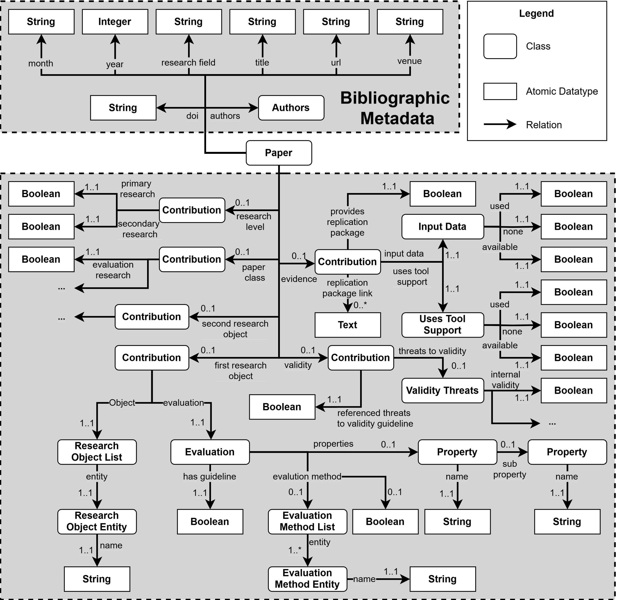
Appendix ORKG Templates
Template of Graph Variant (1)

Slide 42
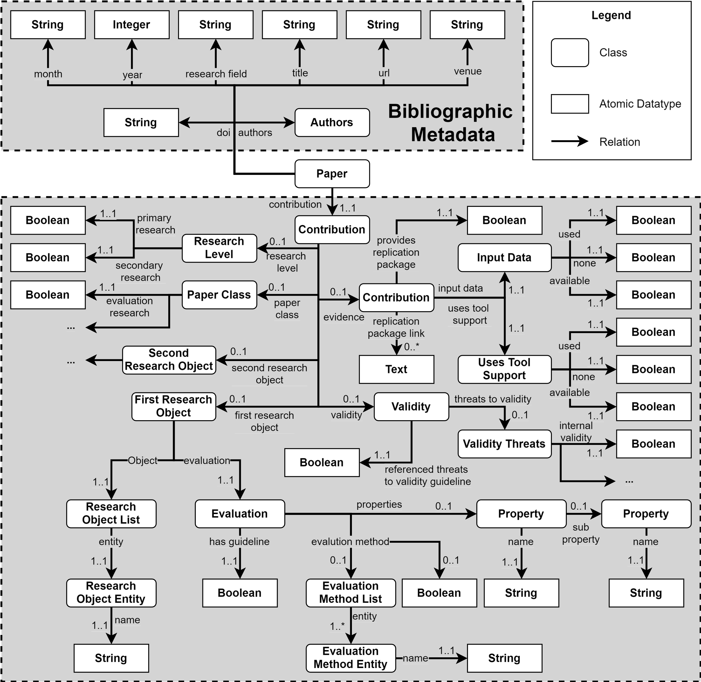
Appendix ORKG Templates
Template of Graph Variant (2)

Slide 43
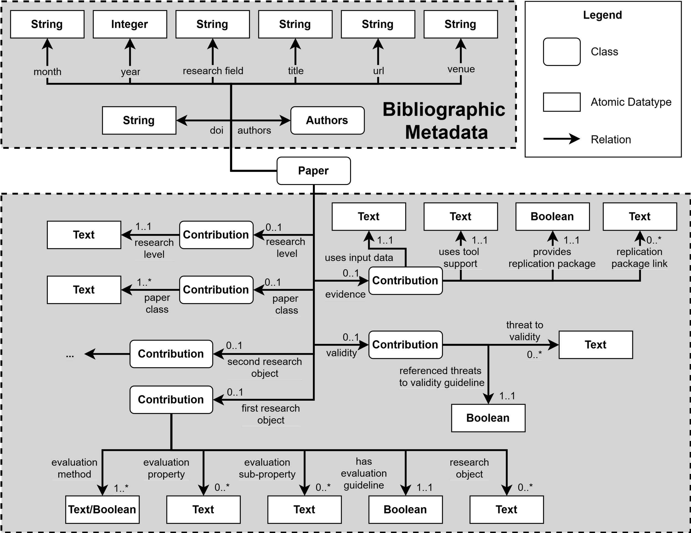
Appendix ORKG Templates
Template of Graph Variant (3)

Slide 44
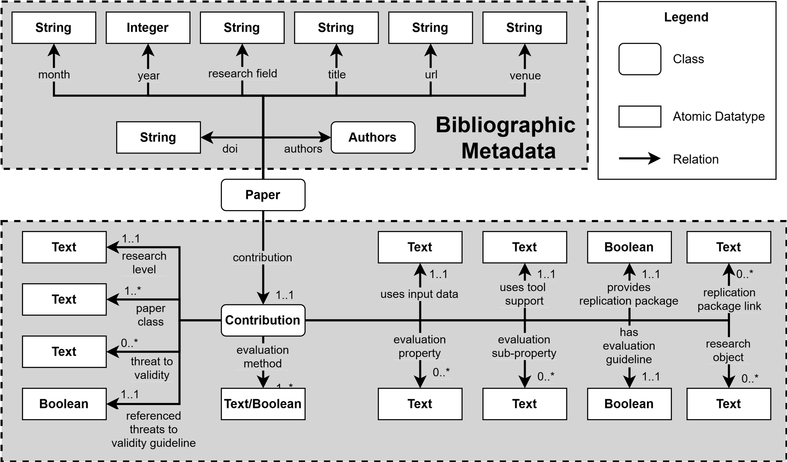
Appendix ORKG Templates
Template of Graph Variant (4)

Slide 45
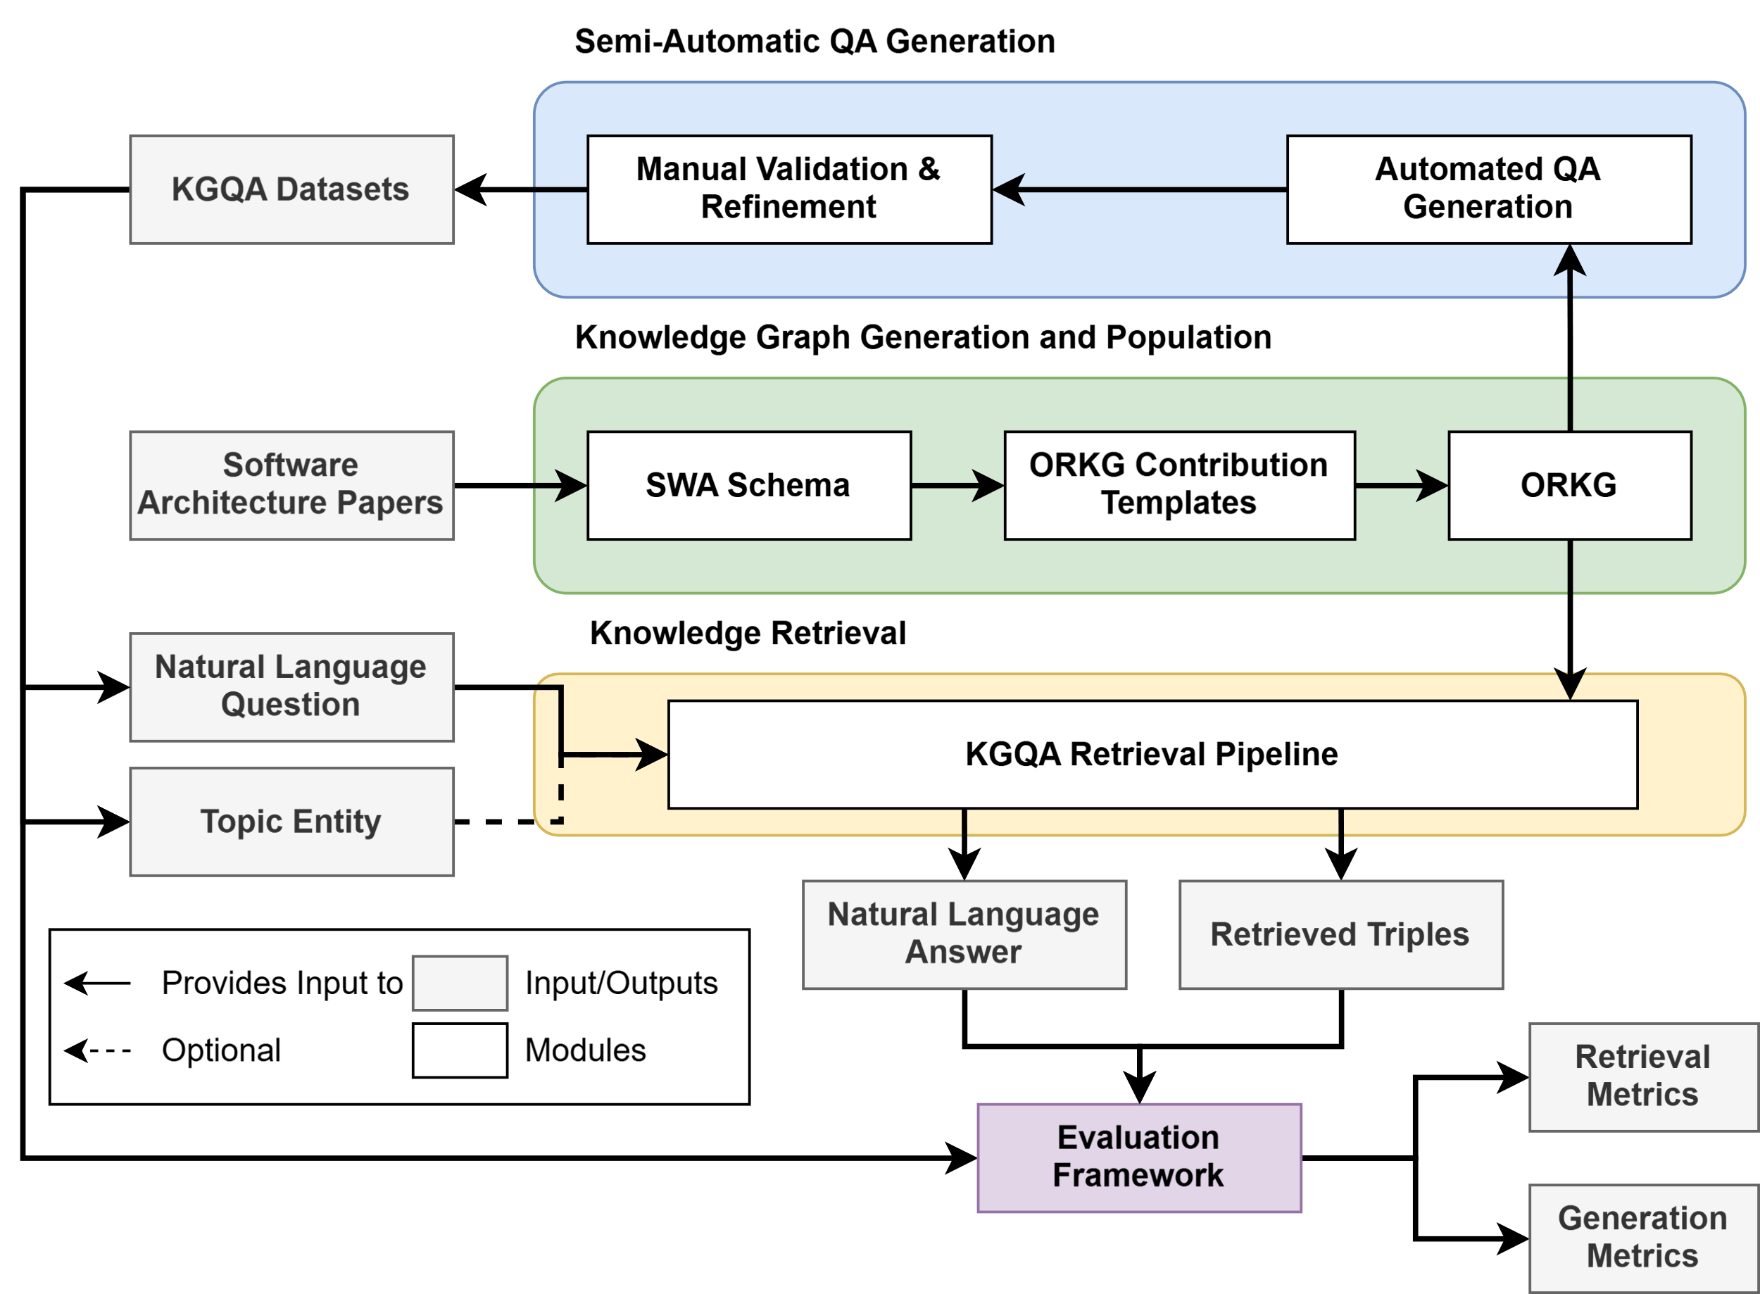
Appendix Experimentation Workflow

Slide 46
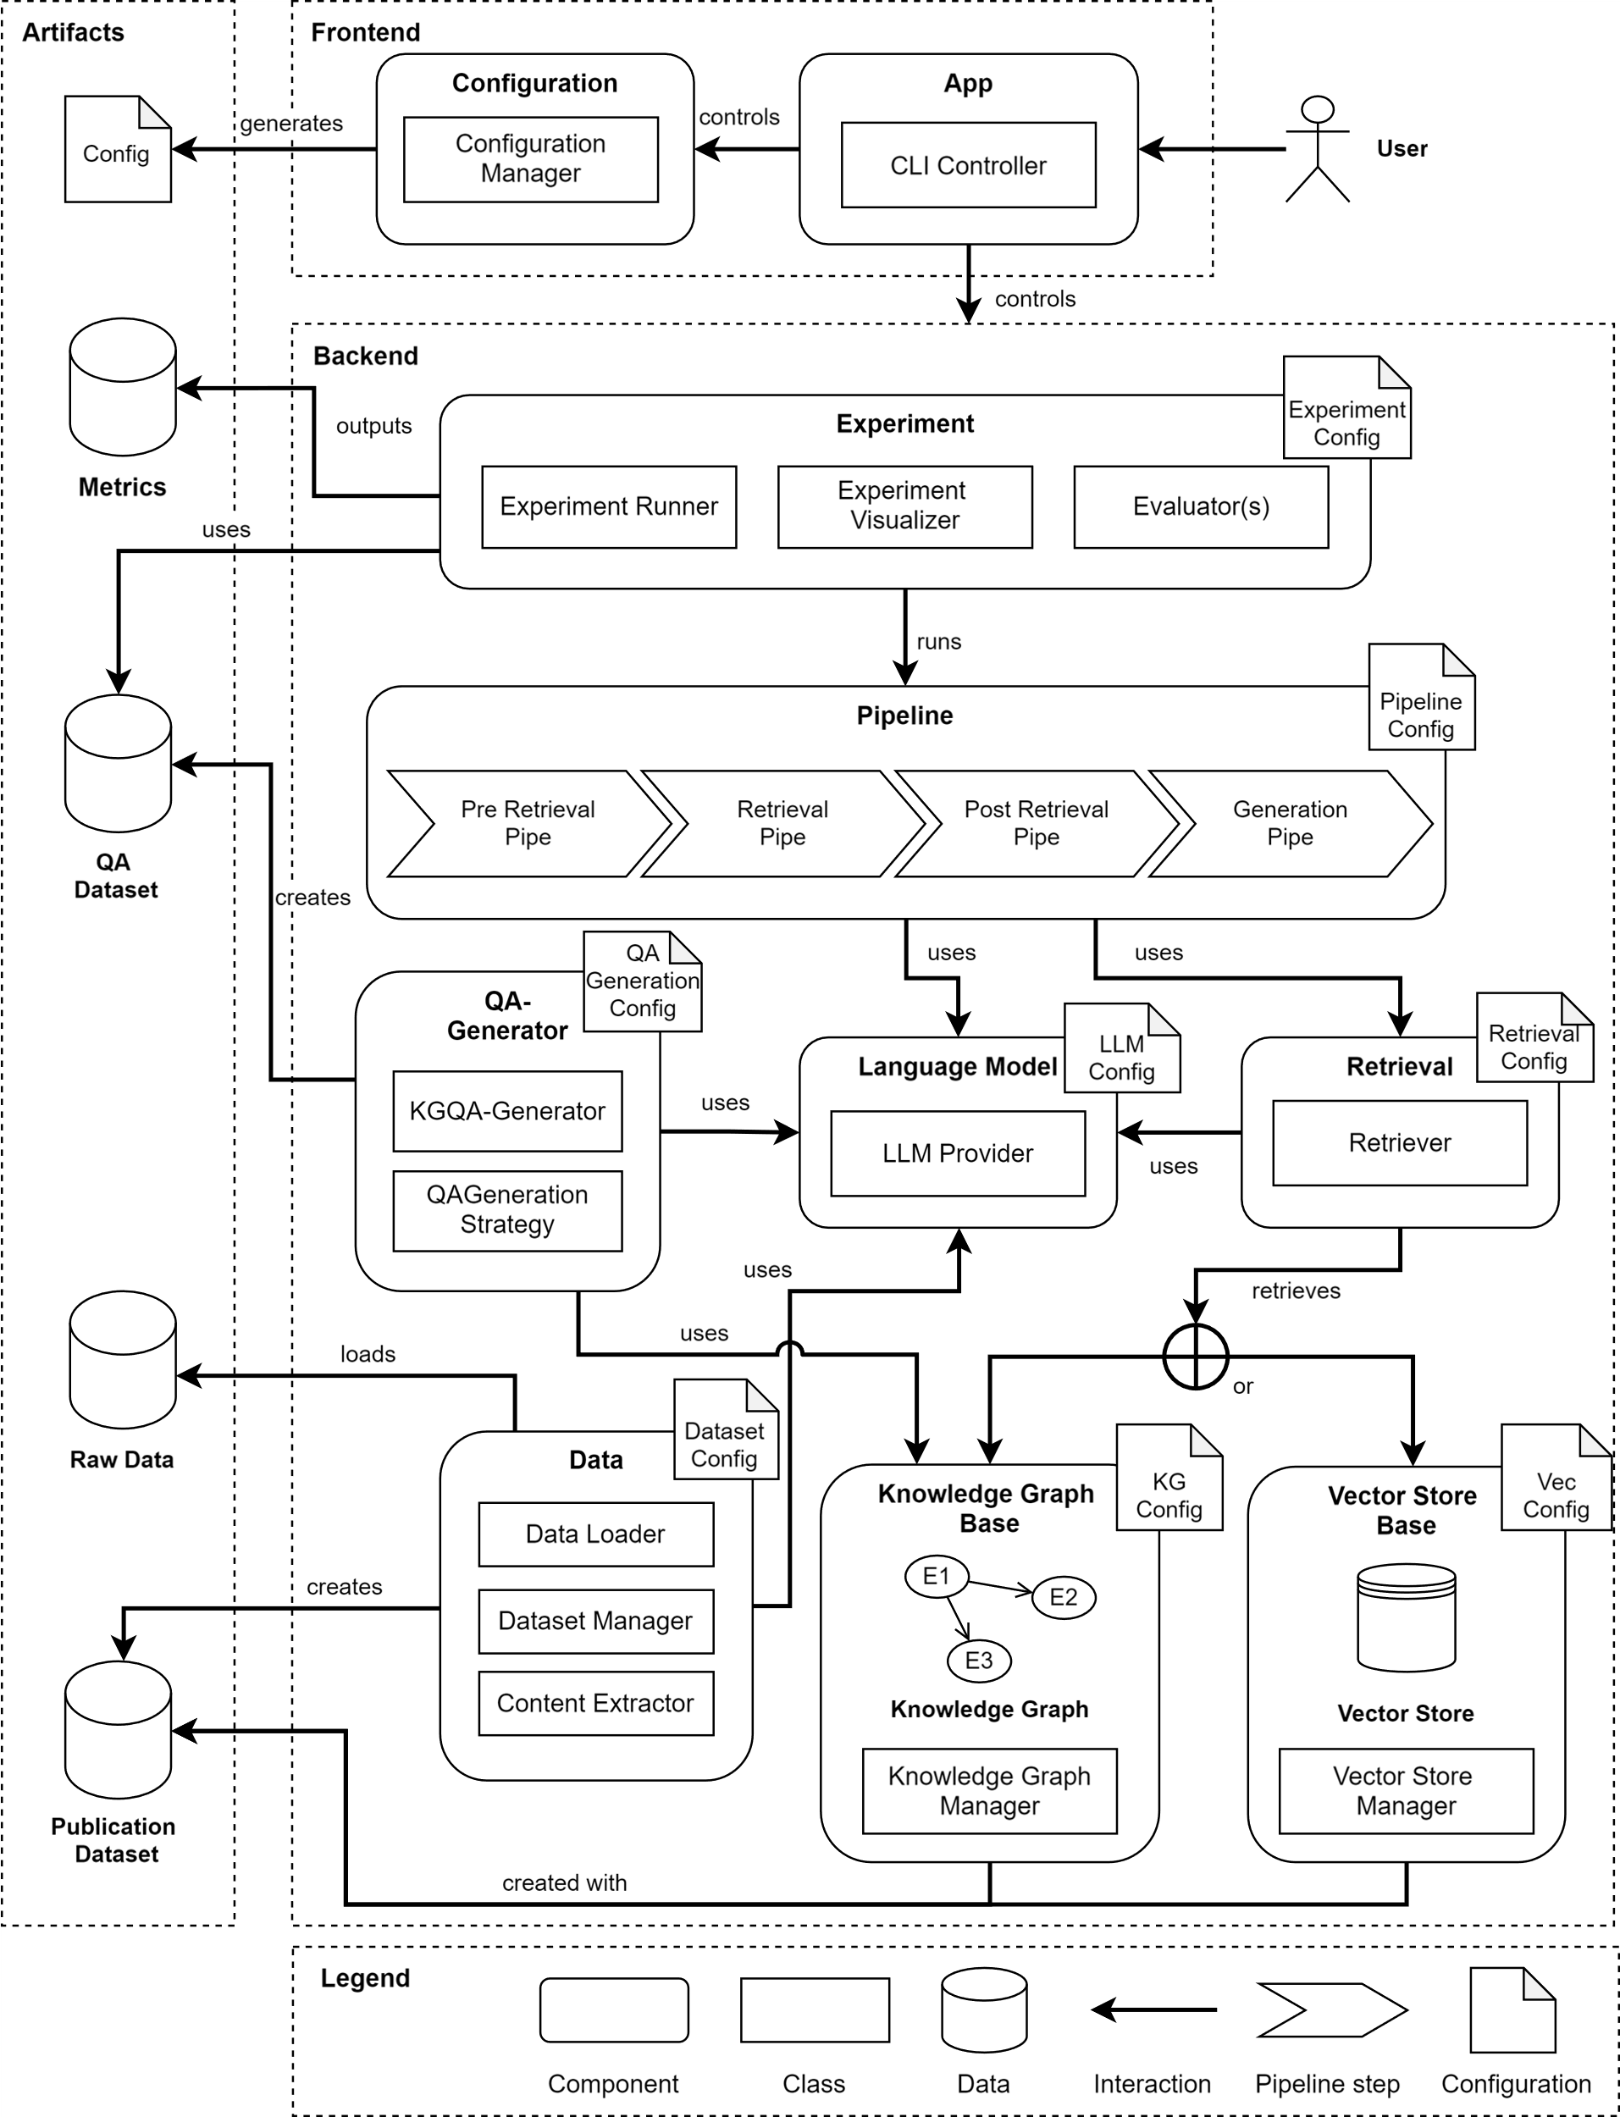
Appendix SQA Framework

Slide 47
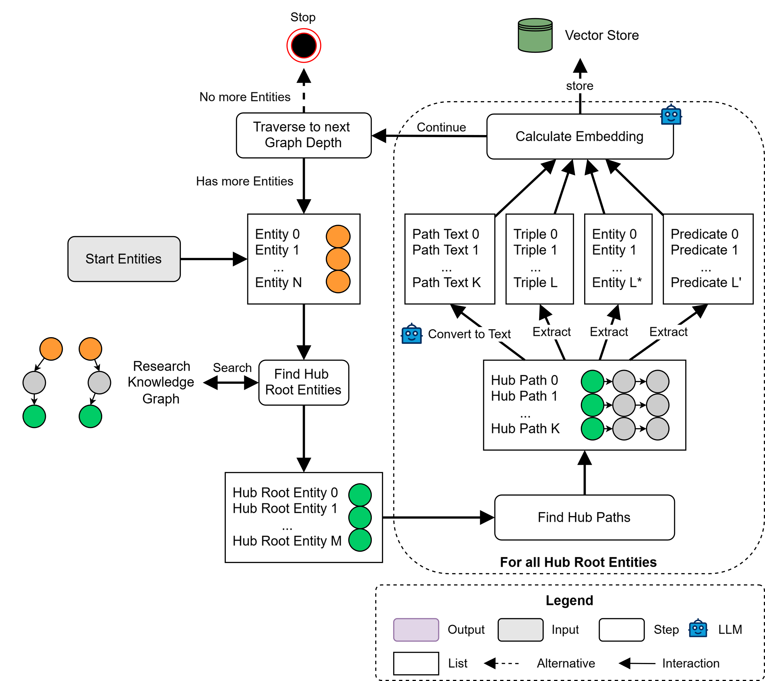
Appendix HubLink Indexing

Slide 48
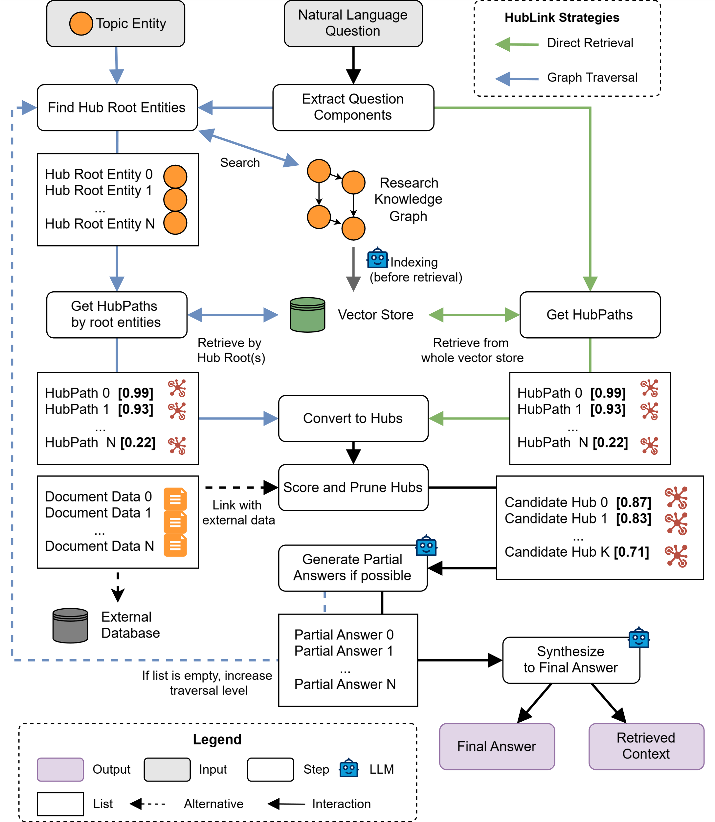
Appendix HubLink Retrieval and Generation

Slide 49
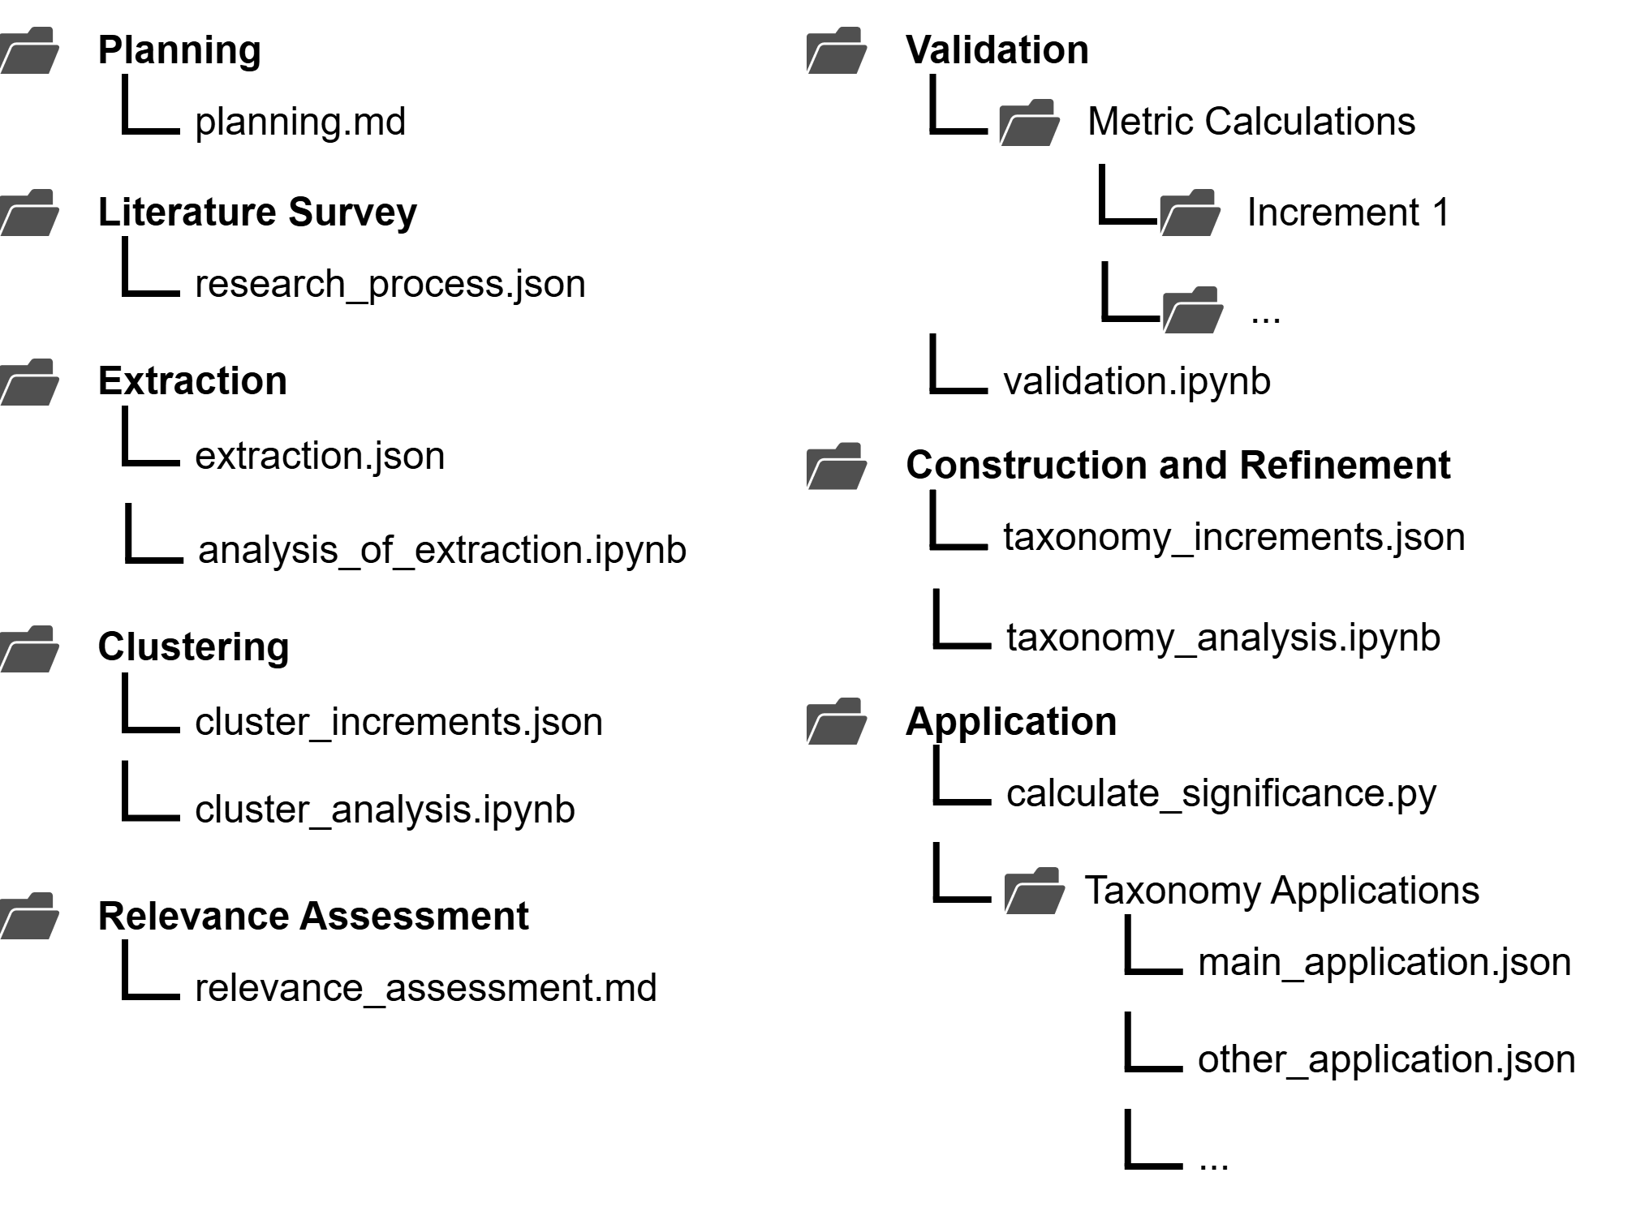
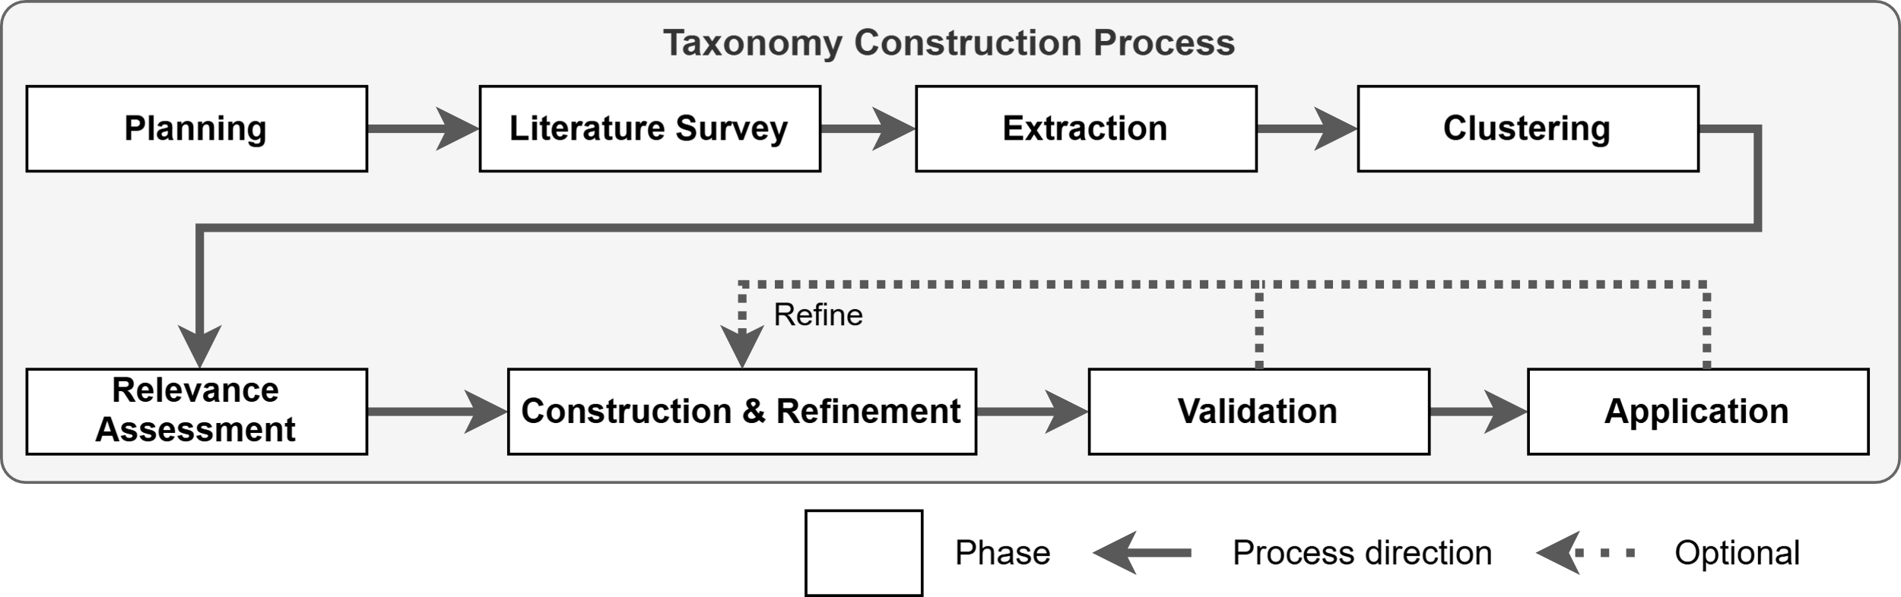
Appendix Taxonomy Construction Process

Slide 50
Appendix KGQA Retrieval Taxonomy
Graph Representation
Single Fact
Multi Fact
Condition Type
• Named Entity
• Description
• Temporal
• Quantitative
• Other Type
Intention Count
• Single Intention
• Multiple Intentions
Question Goal
• Information Lookup
• Reasoning
• Problem Solving
• Problematization
• Improvement
• Prediction
• Other Goal
Answer Type
Named Entity
Description
Temporal
Quantitative
Boolean
Other Type
Retrieval Operation
• Basic
• Relationship
• Negation
• Aggregation
• Counting
• Superlative
• Ranking
• Comparison
Answer Format
• Simple
• Enumerative
• Explanatory
• Other Format
Answer Credibility
• Subjective
• Objective
• Normative

Slide 51
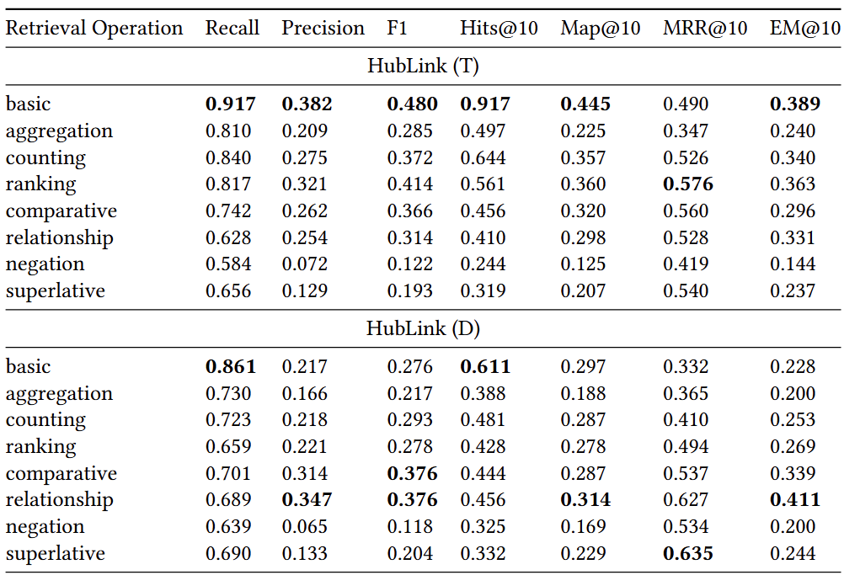
Appendix Retrieval Operation Performance

Slide 52
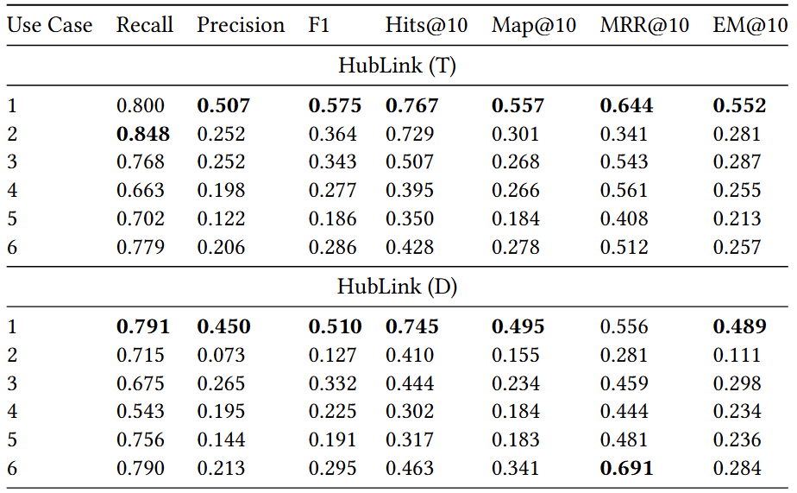
Appendix Use Case Performance

Slide 53
Appendix Retrieval Operation Performance
Use Case 1
Input: Metadata
Output: Metadata
Example:
- Find publications by a specific author
- Search for paper titles by keyword
Use Case 2
Input: Metadata
Output: Content
Example:
- Ask for the conclusions of a specific paper
- Ask what research problems an author has addressed

Slide 54
Appendix Retrieval Operation Performance
Use Case 3
Input: Content
Output: Metadata
Example:
- Find publications that contain a specific evaluation method
- Search for papers treating a certain research problem
Use Case 4
Input: Content
Output: Content
Example:
- Find reference architectures proposed for a specific problem
- Search for definitions/explanations of a concept

Slide 55
Appendix Retrieval Operation Performance
Use Case 5
Input: Metadata + Content
Output: Content
Example:
- Summary of conclusions in a specific time frame for a research problem
- Content answers constrained by both metadata and content
Use Case 6
Input: Metadata + Content
Output: Metadata
Example:
- Find publications that applied a method in a specific field
- Titles of papers matching both content and metadata constraints

Slide 56
Appendix Retrieval Operation Performance
In which venue has the paper '[Metadata: paper title]' been published?
Which publications have been published by the author [Metadata: author name] in the year [publication year]?
Which threats to validity does the paper with the title '[Metadata: paper title]' discuss? Rank the threats to validity in descending alphabetical order.
How many times have [Content Data: research object name] been investigated in [Metadata: year] in comparison to [Metadata: year]?What evaluation methods have been used by the author [Metadata: author name] and were not applied with an evaluation guideline?
What is the distribution of papers that investigate the object [Content Data: research object name] between [Metadata: year] and [Metadata: year]?

